Slide 1
Data Parallelism & Distributed Training
Tran Van Nhiem

Slide 2
Outline
1.
2.
Data Parallelism
Optimization for Accelerate Data Parallelism
3.
4.
Distributed Training
Optimization for Accelerate Distributed Training
5.
Experiment -- Demo

Slide 3
1.
Data Parallelism

Slide 4
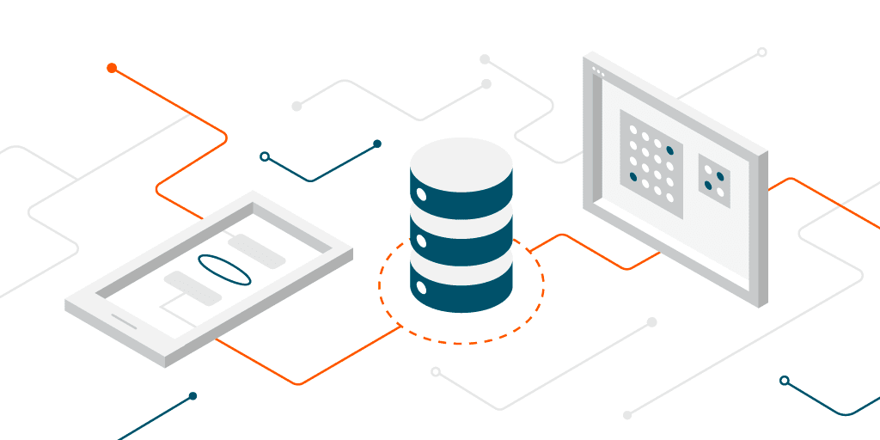
Why Do We Need Data Parallelism?

Slide 5

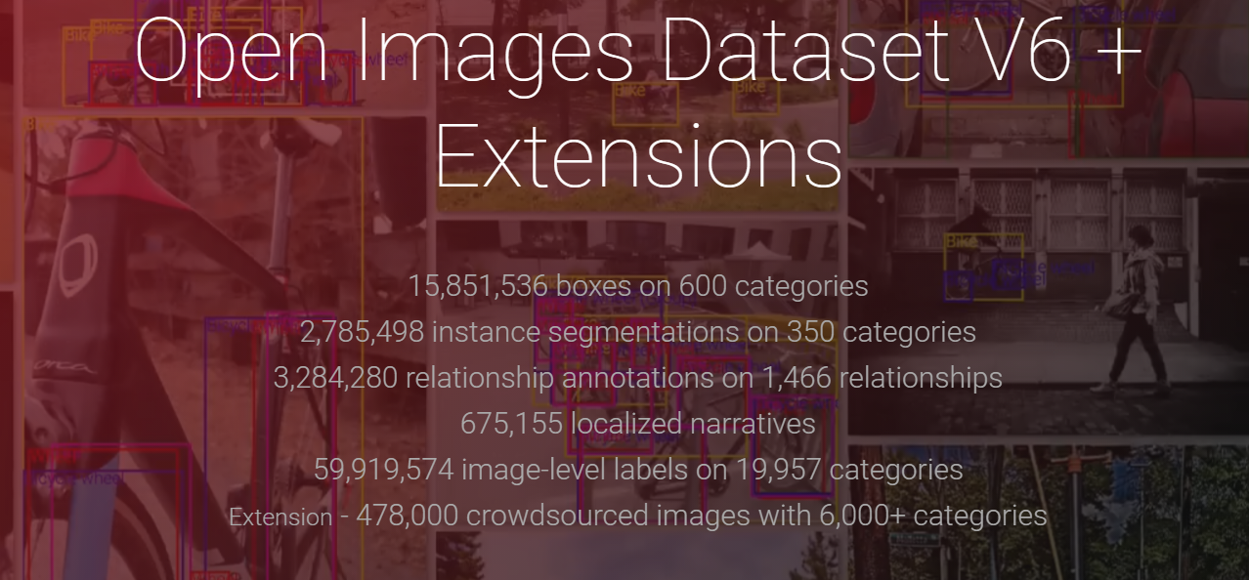

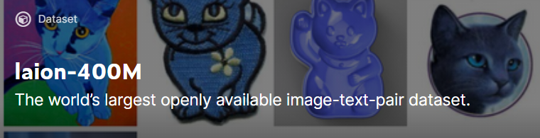
Computer Vision Dataset
1k Classes 1.4 M images
Multi-Tasks Image Dataset (Object Detection, Segmentation, Img Classification)
300M JFT Google Image Classification Dataset
21K Classes 14 M images
400M Multi-Modalities Images-Text Pair Dataset

Slide 6
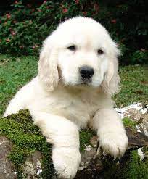
Computer Vision Dataset
256
256
21K Classes 14 M images
Consider Batch-Size Training Our Model [32, 64, 128, 256, 512, 1024]

Slide 7
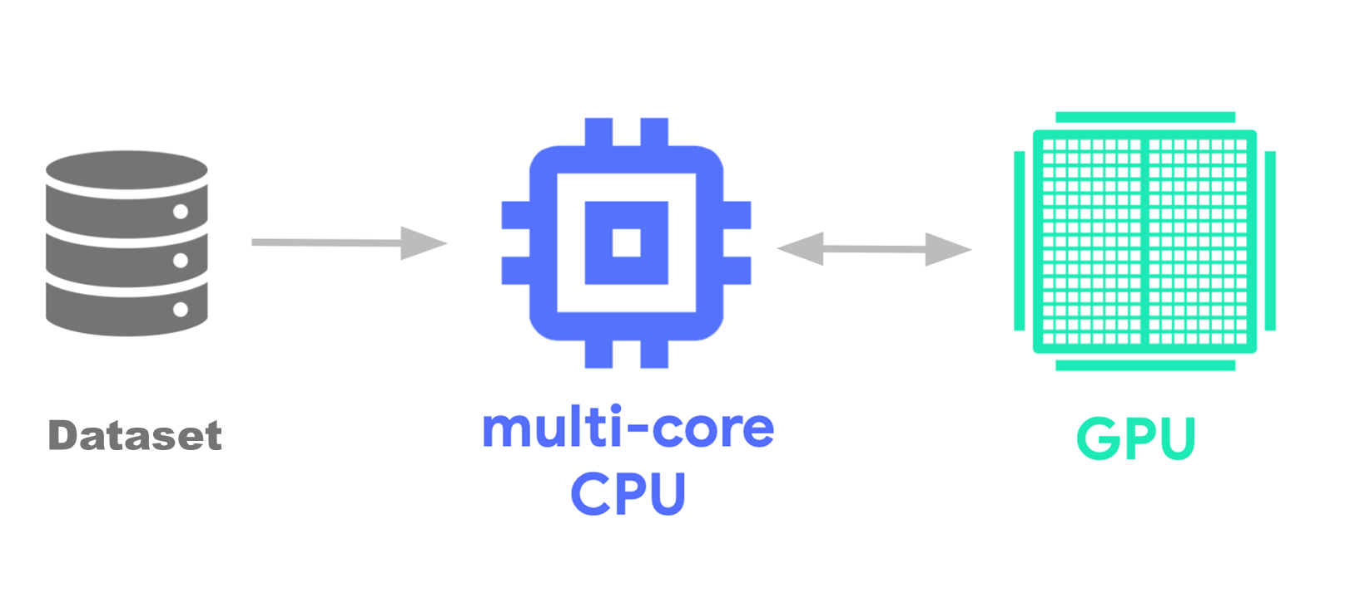
Data Input Pipeline

Slide 8
Data Input Pipeline
Reading data from files in advance: Time spent reading files, including caching, prefetching, and interleaving.
Data preprocessing: Time spent on preprocessing ops, such as image decompression.
Enqueuing data to be transferred to device: Time spent putting data into an infeed queue before transferring the data to the device.

Slide 9
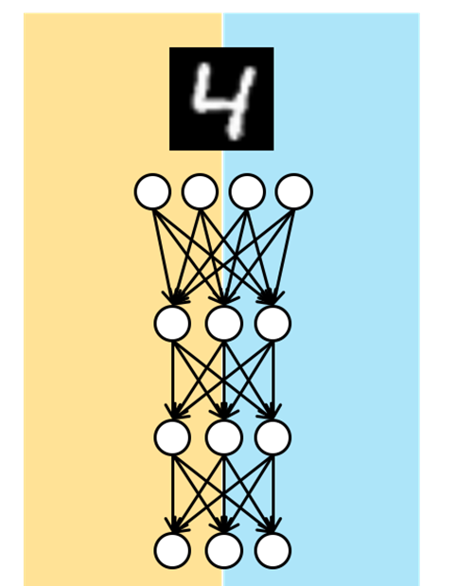
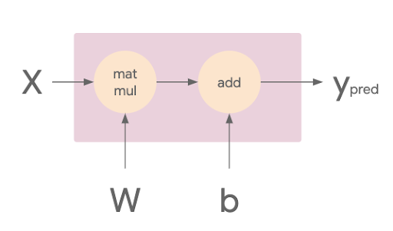
Data Input Pipeline

Slide 10
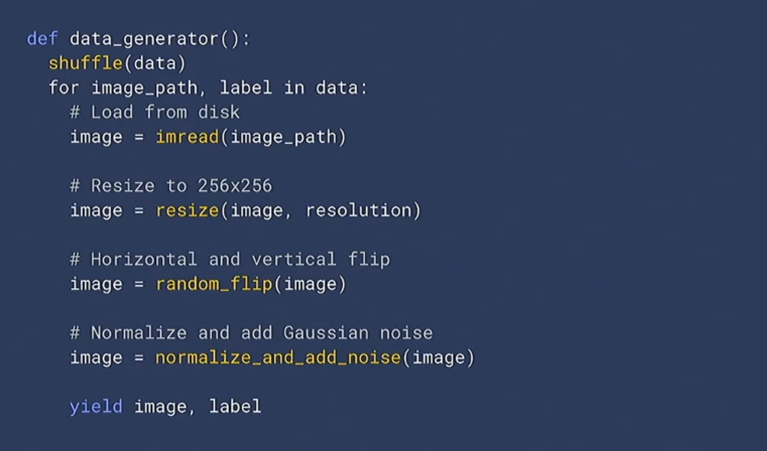
Python Data Generator

Slide 11
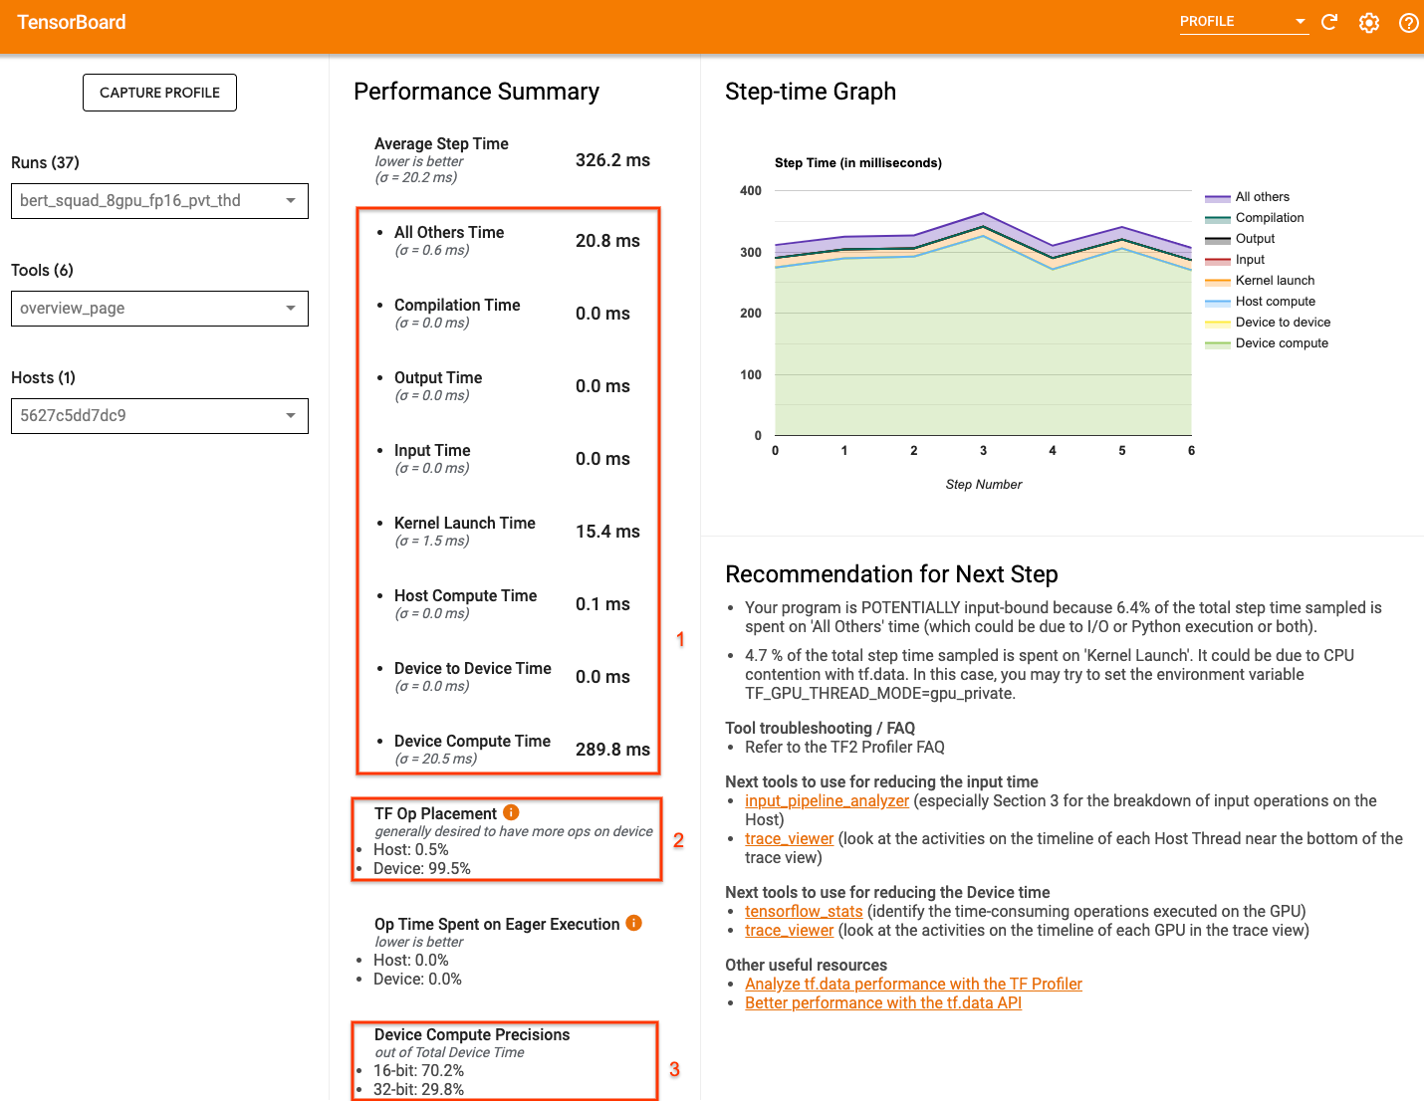
Tensorboard Profile View
1. How much of the step time is from actual device execution
2. The percentage of ops placed on device vs host
3. How many kernels use
➔ Achieving optimal performance maximizing these numbers in all three cases

Slide 12
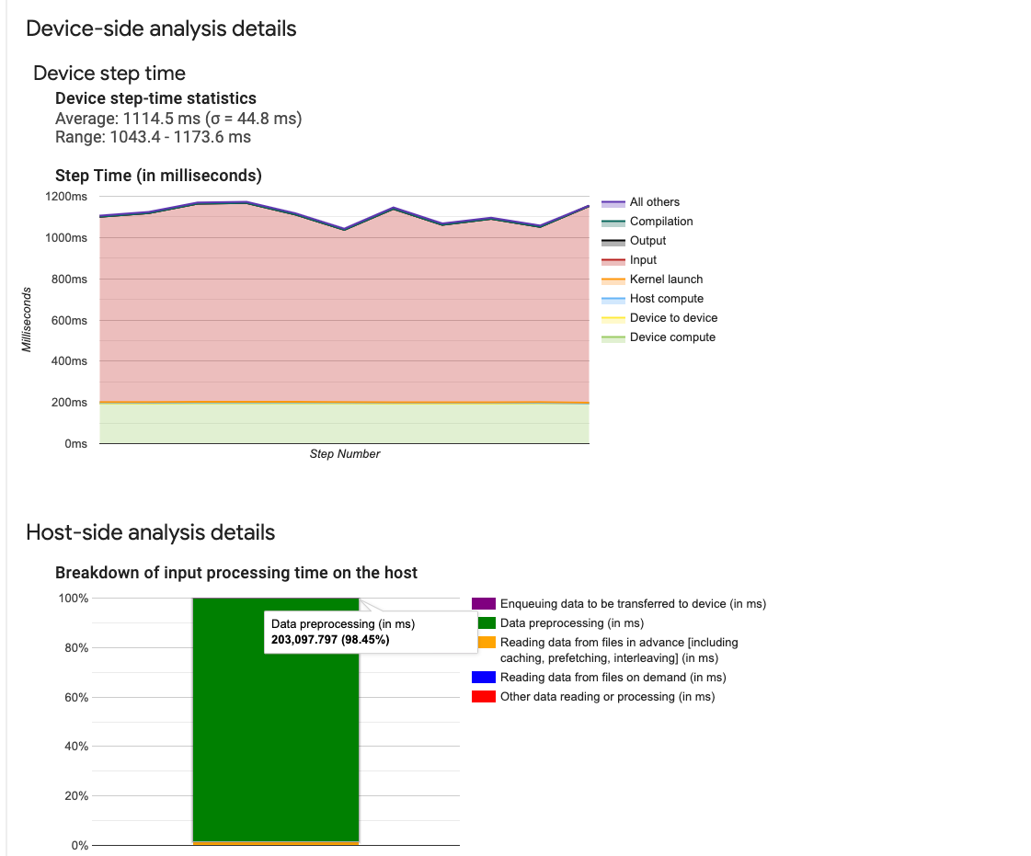
Tensorboard Profile View
Time GPUs Executing Taking Huge a mount of time
Data Processing Taking Huge a mount of time

Slide 13
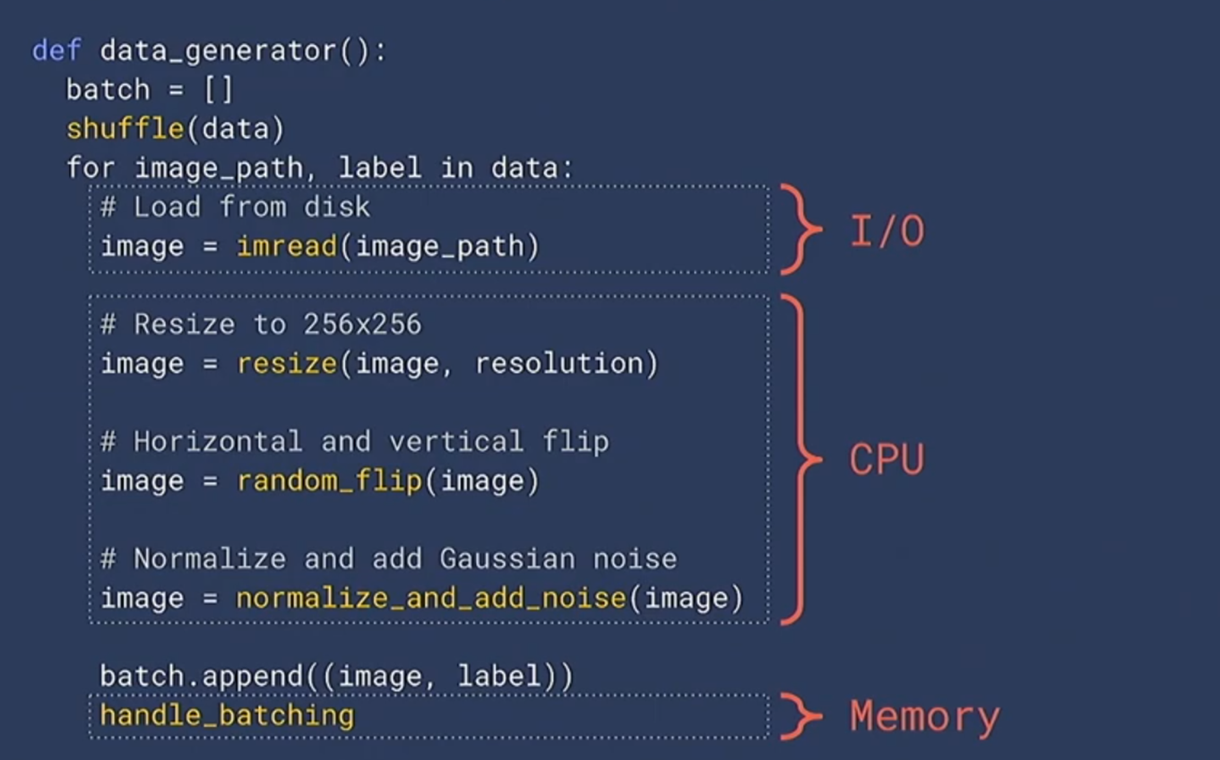
Python Data Generator

Slide 14
2.
Optimization for Accelerate Data Parallelism

Slide 15
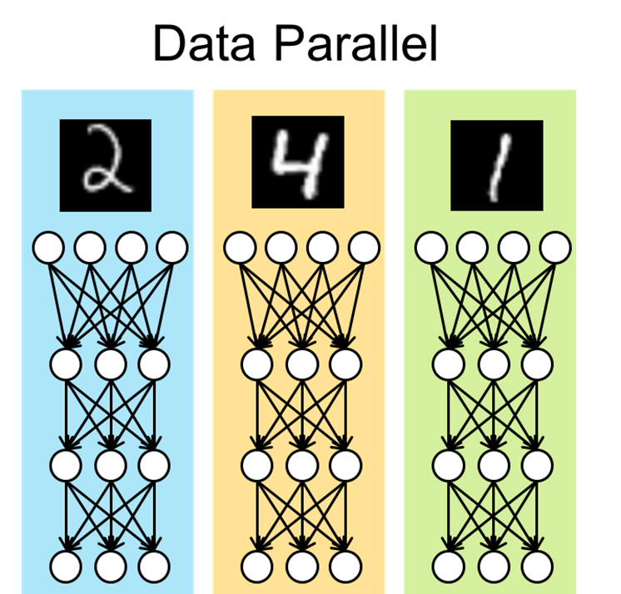
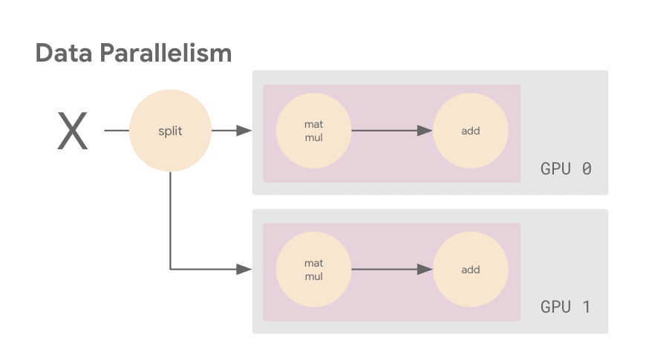
Data Parallelism Input Pipeline

Slide 16


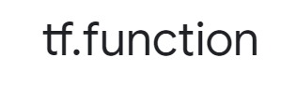
Data Parallelism Input Pipeline

Slide 17
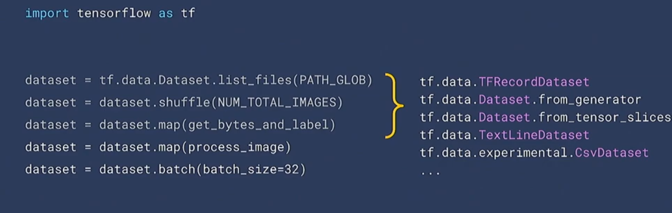
tf.data.Dataset Data Parallelism Input Pipeline

Slide 18
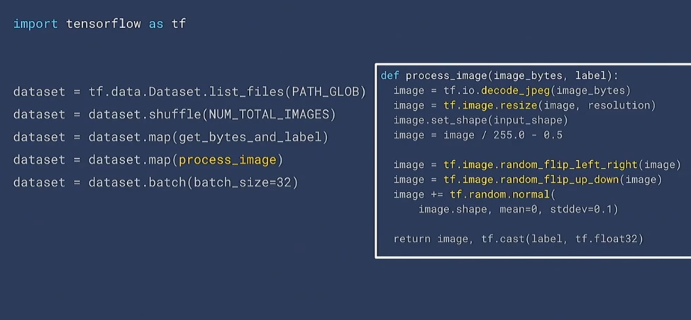
tf.data.Dataset Data Parallelism Input Pipeline

Slide 19
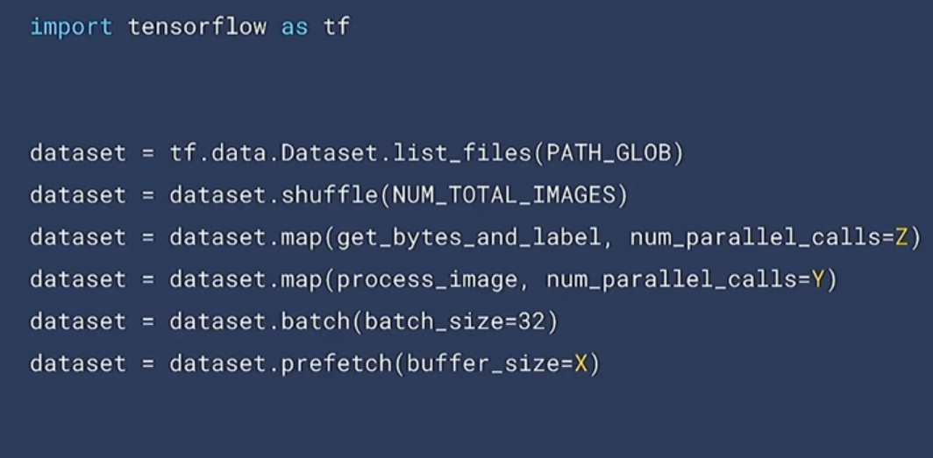
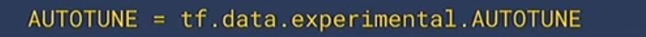
tf.data.Dataset Data Parallelism Input Pipeline

Slide 20
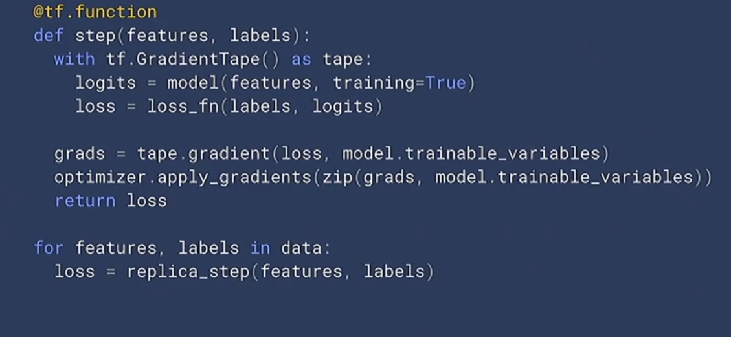
tf.function Data Parallelism Input Pipeline

Slide 21
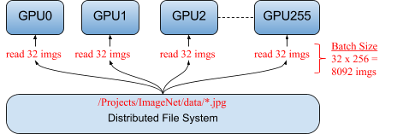
Data Parallelism Input Pipeline

Slide 22
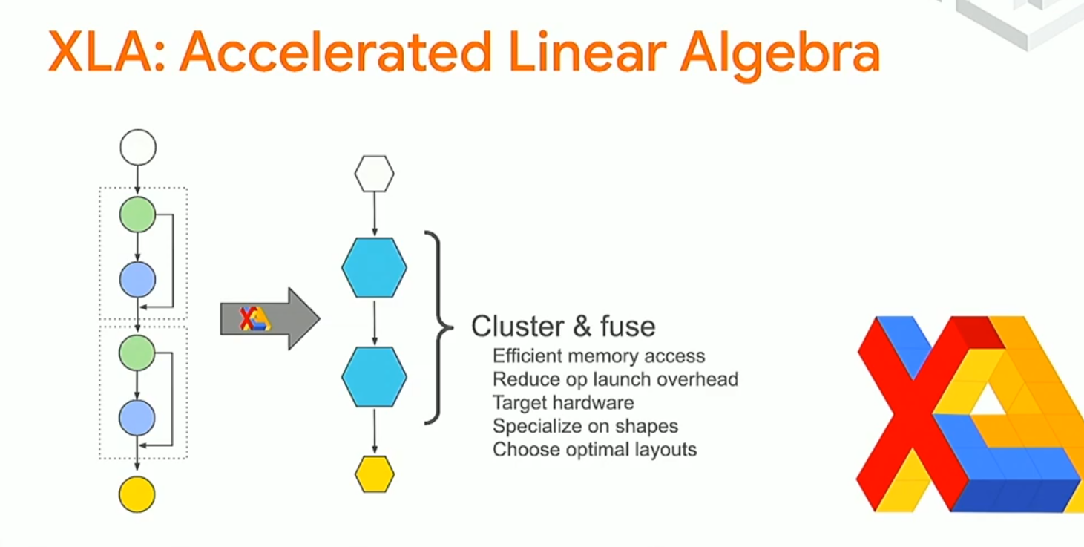
Under Experiment Data Parallelism Input Pipeline

Slide 23
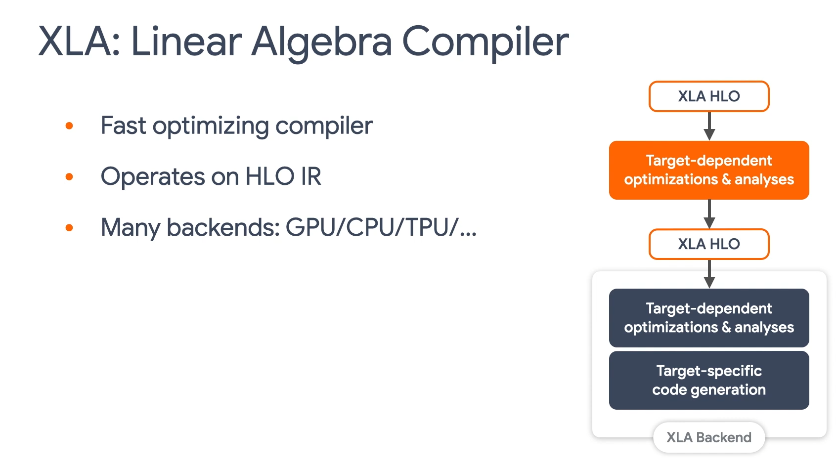
Under Experiment Data Parallelism Input Pipeline

Slide 24
3.
Distributed Training

Slide 25
Single Input-Output Training Pipeline

Slide 26
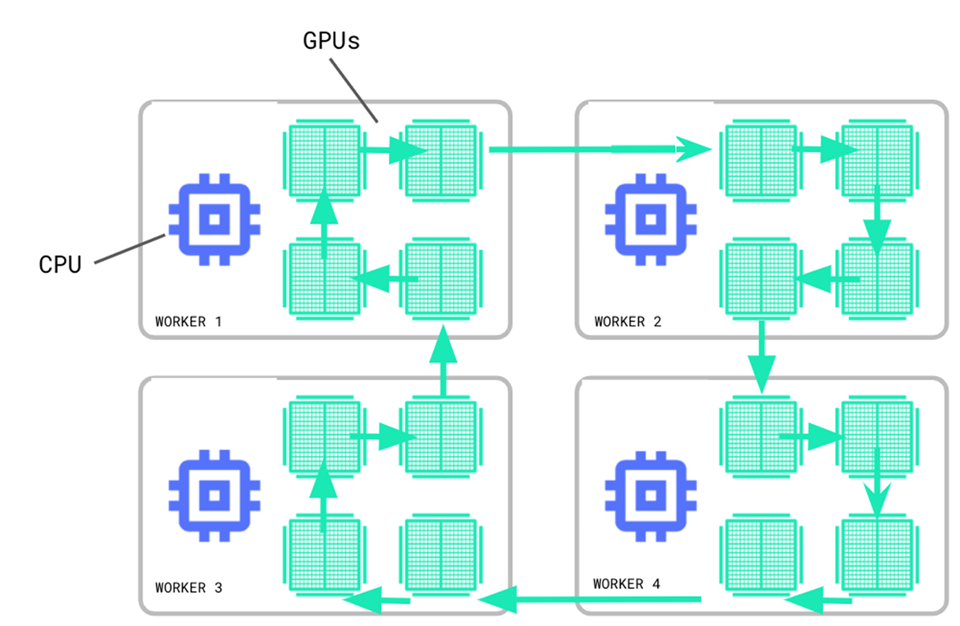
Multiple Input-Output Training Pipeline

Slide 27
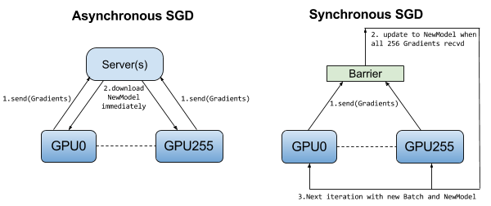
Synchronous vs Asynchronous Training Pipeline

Slide 28
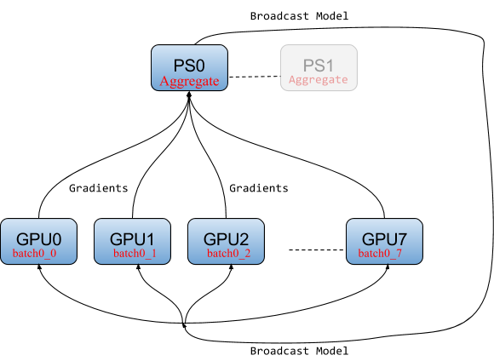
Synchronous Training Pipeline

Slide 29
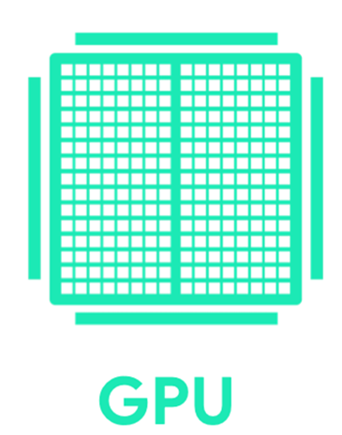
Synchronous Training Pipeline
Input 1
Input 2
Input 3
Layer A: V0
Layer A: V1
Layer A: V2
Forward Path
Layer B: V0’
Layer B: V1’
Layer B: V2’
Layer A: V0
Layer A: V1
Layer A: V2
Backward Propagation
Grad-Aggregates
Grad-Aggregates
Layer B: V0’
Layer B: V1’
Layer B: V2’
Device 1
Device 2
Device 3

Slide 30

Synchronous Training Pipeline

Slide 31
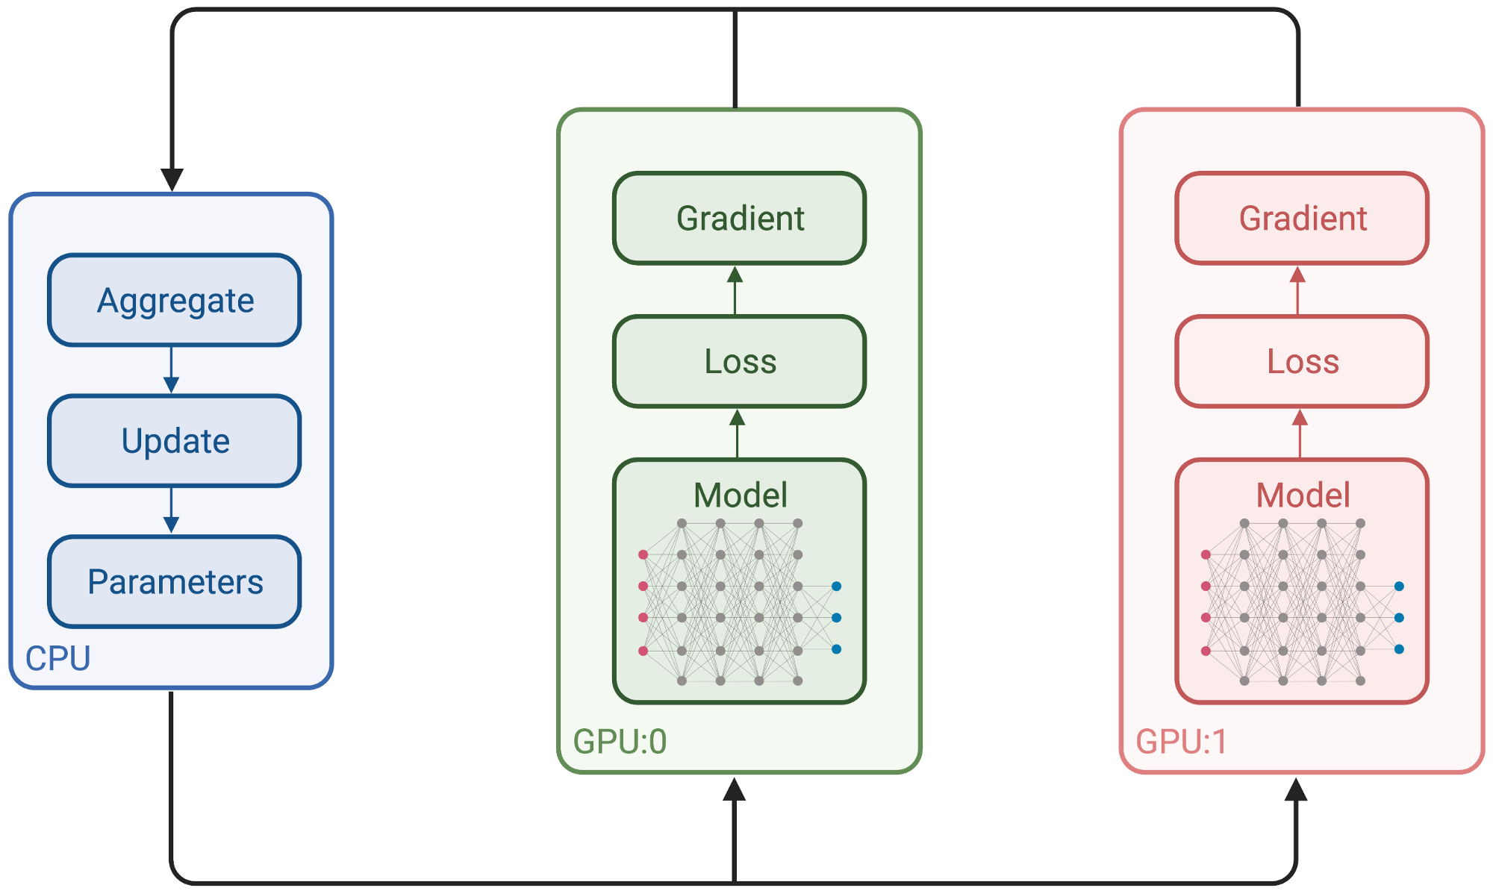
Synchronous Training Pipeline
For One Node Multi-GPUs

Slide 32
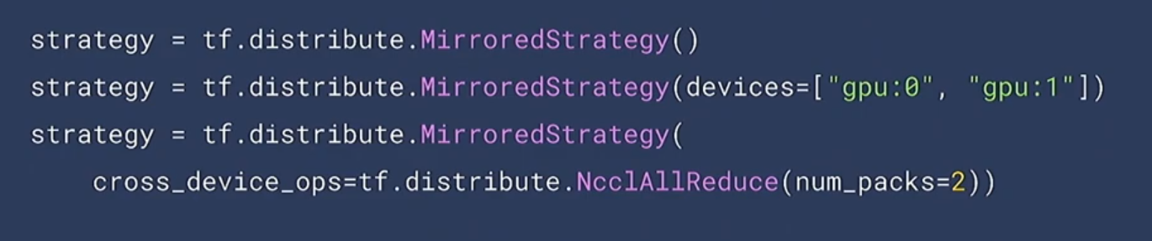
Synchronous Training Pipeline
For One Node Multi-GPUs

Slide 33
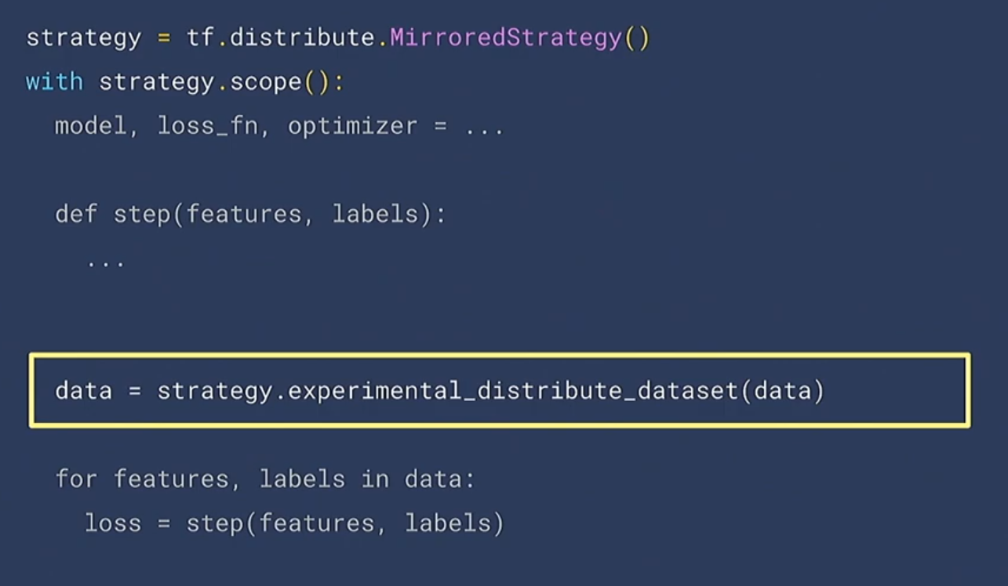
Synchronous Training Pipeline (1Node-Multi-GPUs)
Data splitting to many small batches cross --GPUs

Slide 34
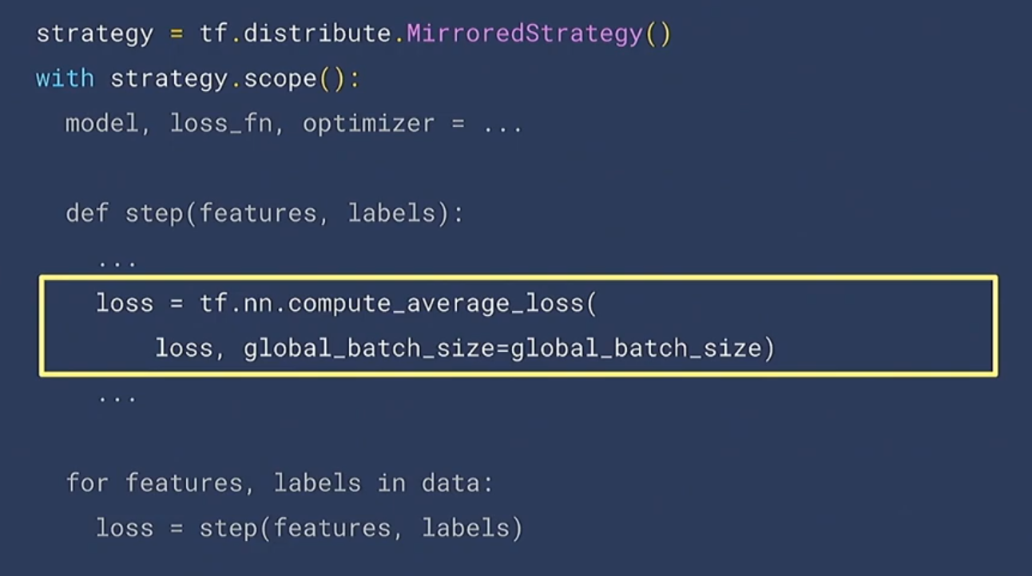
Synchronous Training Pipeline (1Node-Multi-GPUs)
Compute average Loss across multi-GPUs

Slide 35
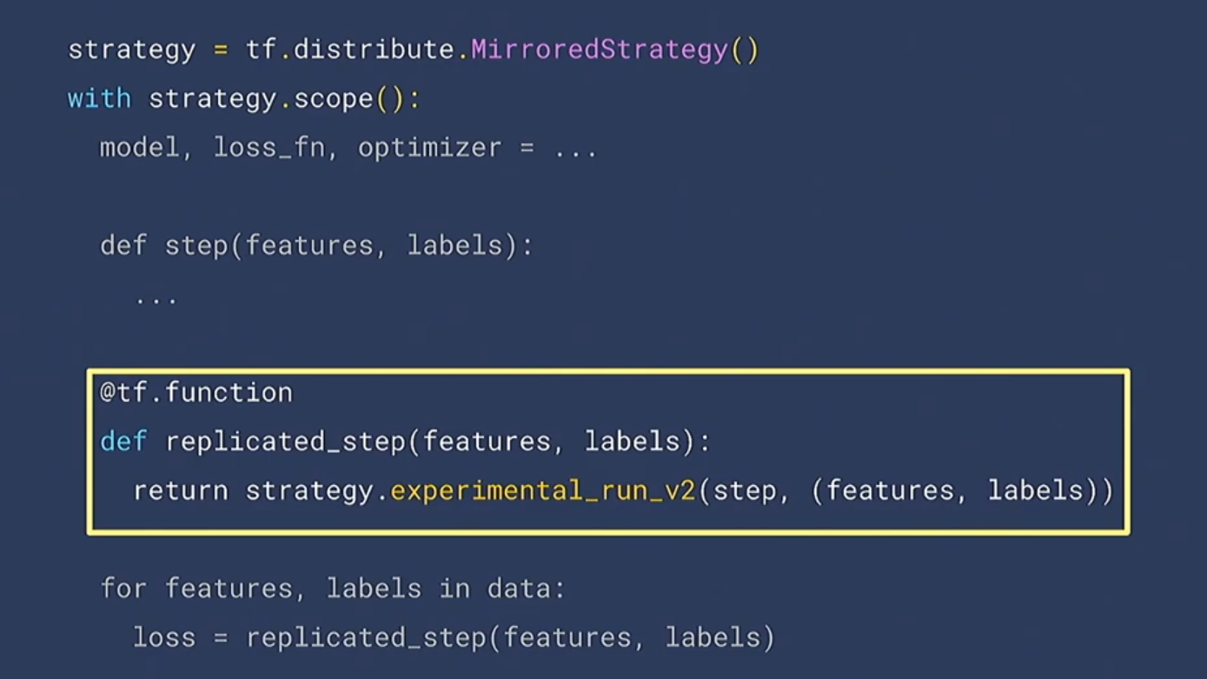
Synchronous Training Pipeline (1Node-Multi-GPUs)
Replica strategy in Multiple machine → Computation replicate (training steps)

Slide 36
Synchronous Training Pipeline For Multi Nodes Multi-GPUs

Slide 37
Synchronous Training Pipeline
For Multi-Nodes

Slide 38
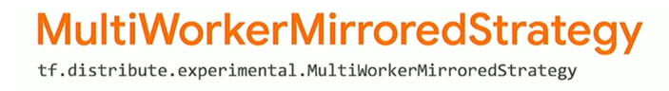
Inherence from MirroredStrategy()
Synchronous Training Pipeline For Multi Nodes Multi-GPUs

Slide 39
4.
Optimization for Accelerate Distributed Training

Slide 40
Synchronous Training Pipeline
Input 1
Input 2
Input 3
Layer A: V0
Layer A: V1
Layer A: V2
Forward Path
Layer B: V0’
Layer B: V1’
Layer B: V2’
Layer A: V0
Layer A: V1
Layer A: V2
Backward Propagation
Grad-Aggregates
Grad-Aggregates
Layer B: V0’
Layer B: V1’
Layer B: V2’
Device 1
Device 2
Device 3

Slide 41
Optimization Synchronous Training For Multi Nodes Multi-GPUs
Increasing Throughput
Three Strategies
+ Gradient AllReduce (NCCL) Tuning (Boosting in Gradient Aggregate in Multi-Workers)
+ Using Mix Precision for Training (FP16 –FP32)
+ Overlapping Gradient Allreduce with Backprop computation

Slide 42
Synchronous Training Multi-Nodes
NCCL Throughput

Slide 43
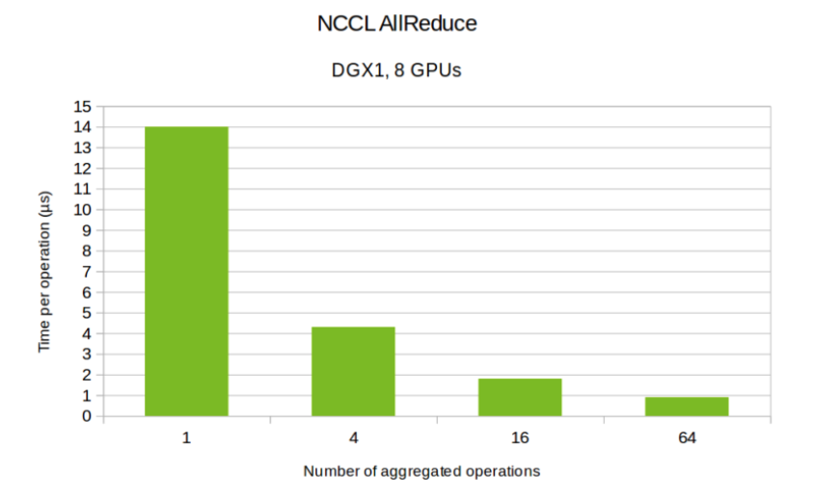
NCCL AllReduce For Multi Nodes Multi-GPUs
Nvidia-Benchmark
Nvidia NCCL AllReduce GPU Test
https://github.com/nvidia/nccl-tests

Slide 44
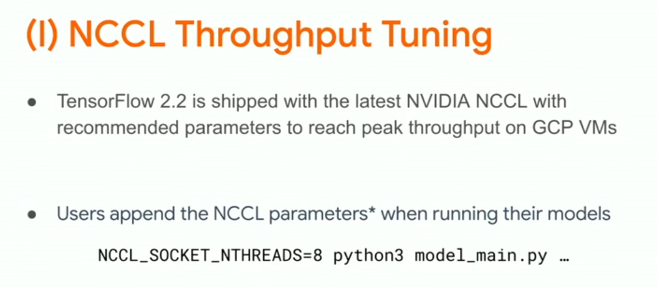
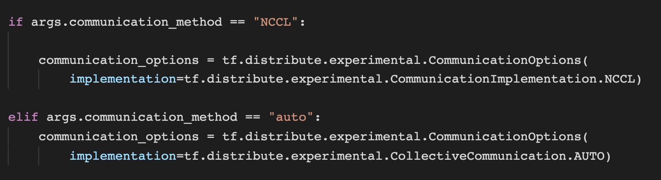
Optimization NCCL AllReduce For Multi Nodes Multi-GPUs

Slide 45
Synchronous Training Multi-Nodes
Mix-Preicision Throughput

Slide 46
Synchronous Training Pipeline
Input 1
Input 2
Input 3
Layer A: V0
Layer A: V1
Layer A: V2
Forward Path
Layer B: V0’
Layer B: V1’
Layer B: V2’
Calculating at FP 16 → Result convert back to FP32
Layer A: V0
Layer A: V1
Layer A: V2
Backward Propagation
Grad-Aggregates
Grad-Aggregates
Layer B: V0’
Layer B: V1’
Layer B: V2’
Device 1
Device 2
Device 3

Slide 47
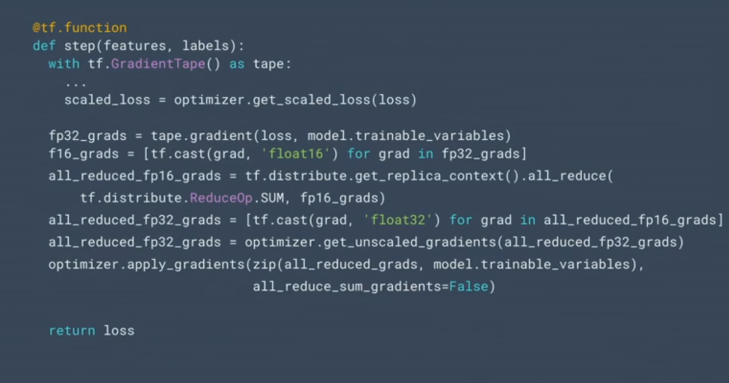
Optimization Mix-Precision (FP16-FP8) Multi Nodes Multi-GPUs
Increasing Throughput

Slide 48
Optimization Mix-Precision (FP16-FP8) Multi Nodes Multi-GPUs
Increasing Throughput
Convert Gradient to FP16 instead of FP32

Slide 49
Optimization Mix-Precision (FP16-FP8) Multi Nodes Multi-GPUs
Increasing Throughput
Convert Gradient to FP16 instead of FP32
All gradients aggregate with FP16 Gradients

Slide 50
Optimization Mix-Precision (FP16-FP8) Multi Nodes Multi-GPUs
Increasing Throughput
Convert back gradient to FP32

Slide 51
Optimization Mix-Precision (FP16-FP8) Multi Nodes Multi-GPUs
Increasing Throughput
Convert back gradient to FP32
FP32 assigned to Layers variables apply optimizer to optimize .

Slide 52
Optimization Mix-Precision (FP16-FP8) Multi Nodes Multi-GPUs
Increasing Throughput
Convert Gradient to FP16 instead of FP32
All gradients aggregate with FP16 Gradients
Convert back gradient to FP32
FP32 assigned to Layers variables apply optimizer to optimize .

Slide 53
Synchronous Training Multi-Nodes
Overlapping Throughput

Slide 54
Synchronous Training Pipeline
Input 1
Input 2
Input 3
Layer A: V0
Layer A: V1
Layer A: V2
Forward Path
Layer B: V0’
Layer B: V1’
Layer B: V2’
Layer A: V0
Layer A: V1
Layer A: V2
Grad-Aggregates
Backward Propagation
Grad-Aggregates
Layer B: V0’
Layer B: V1’
Layer B: V2’
Running Parallel Compute Gradient
Device 1
Device 2
Device 3

Slide 55
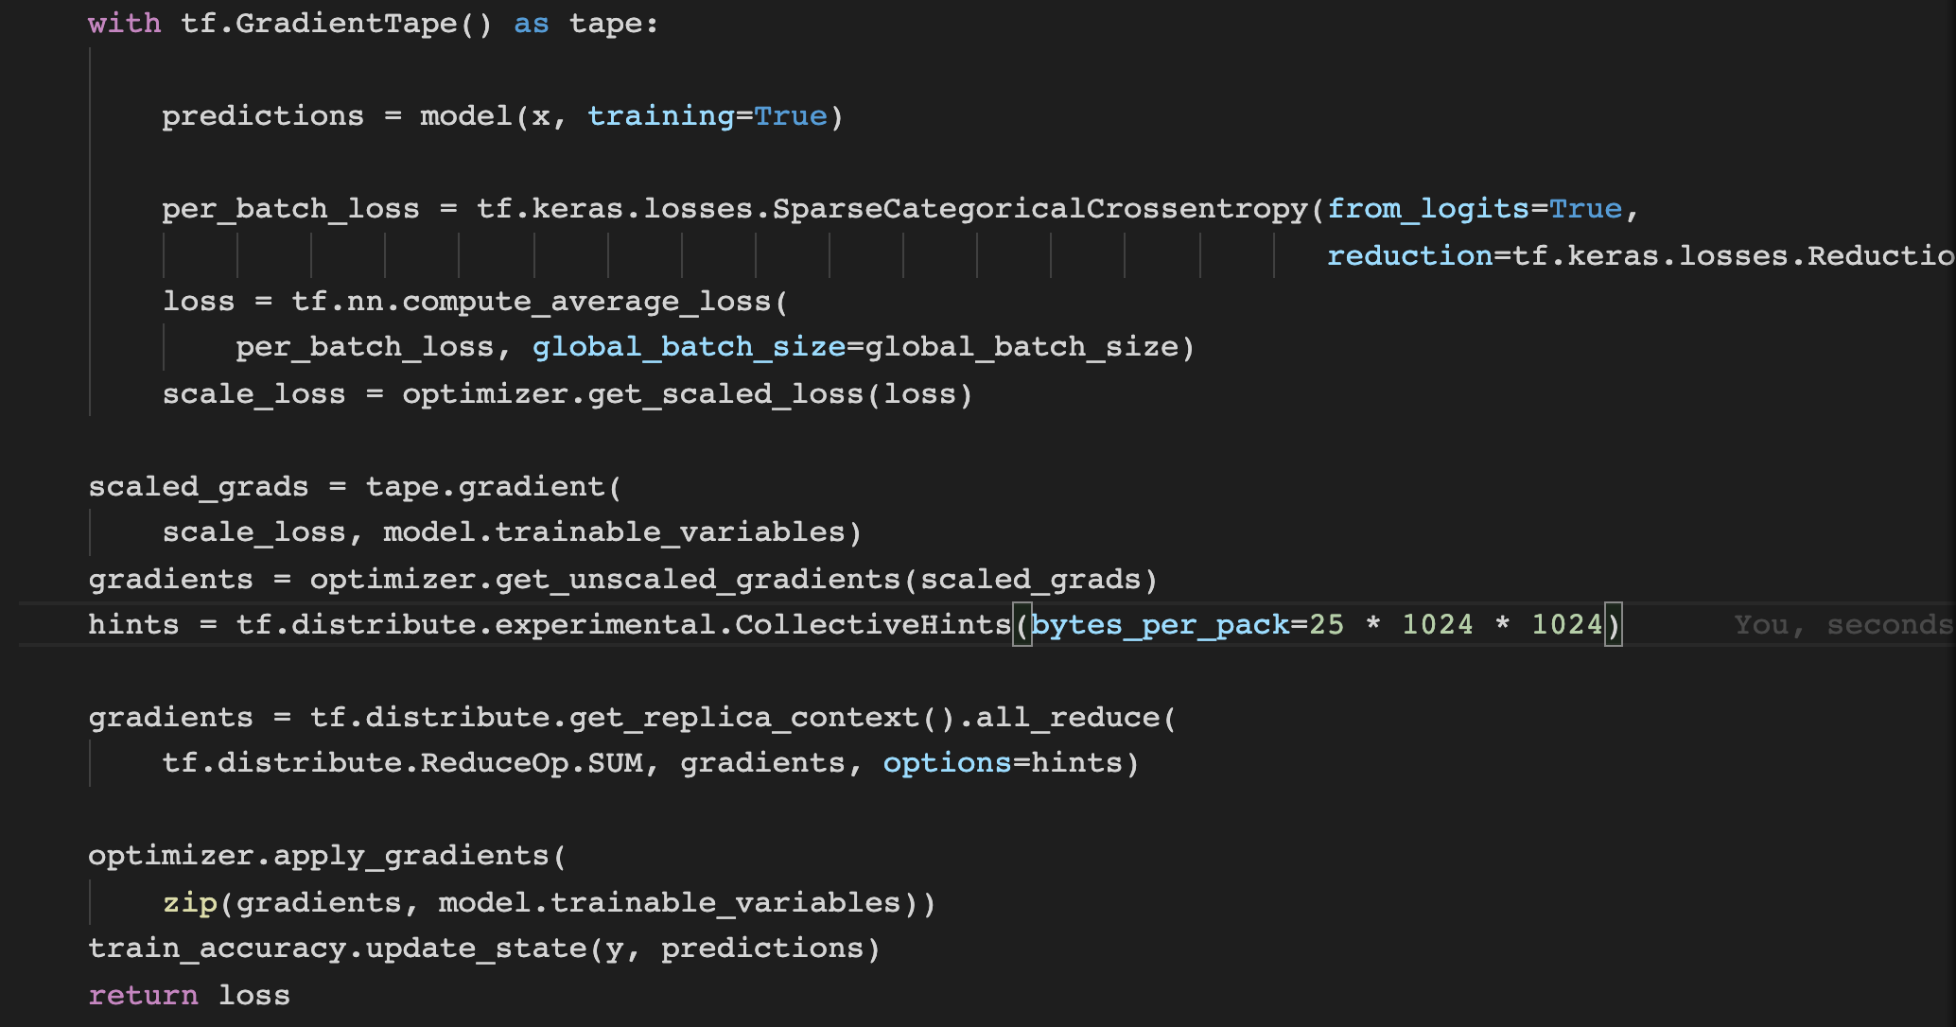
Experiment Optimization Overlapping Gradient Backpropagation

Slide 56
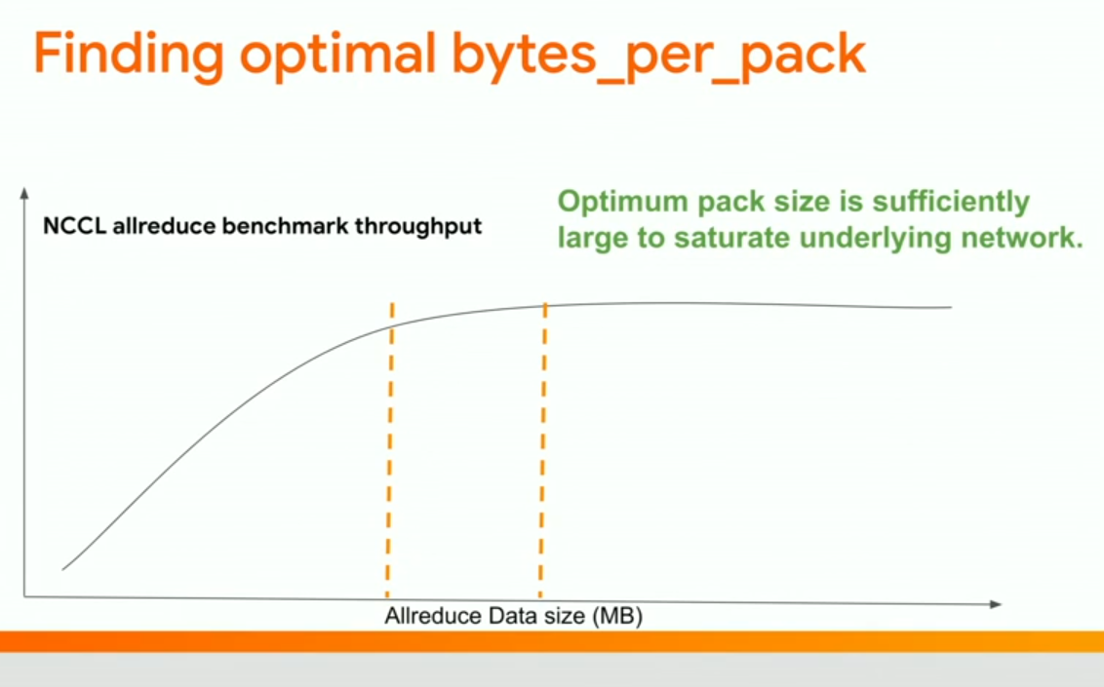
Experiment Optimization Overlapping Gradient Backpropagation

Slide 57
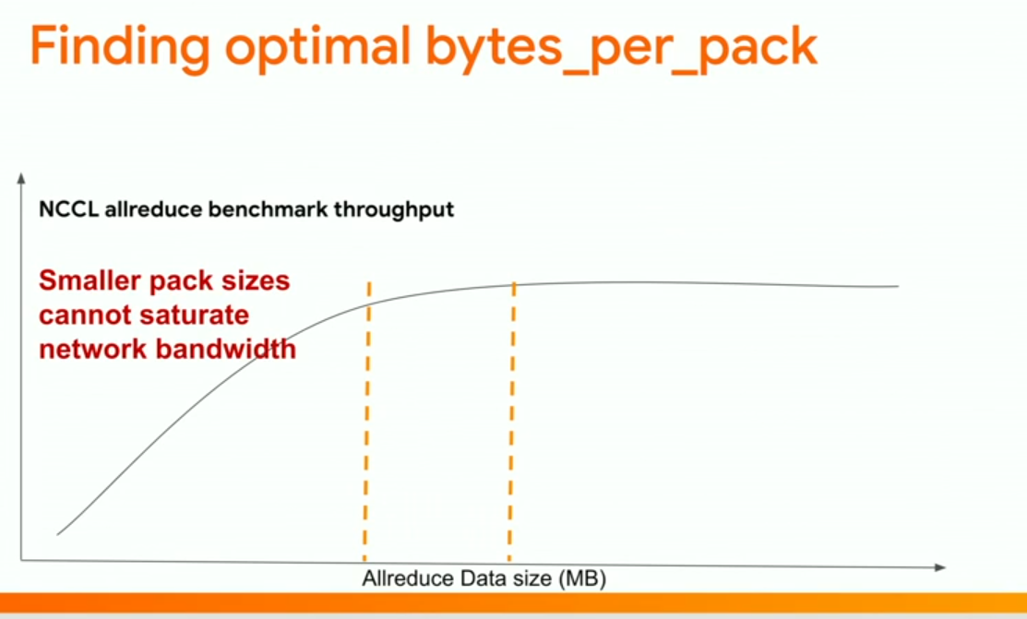
Experiment Optimization Overlapping Gradient Backpropagation

Slide 58
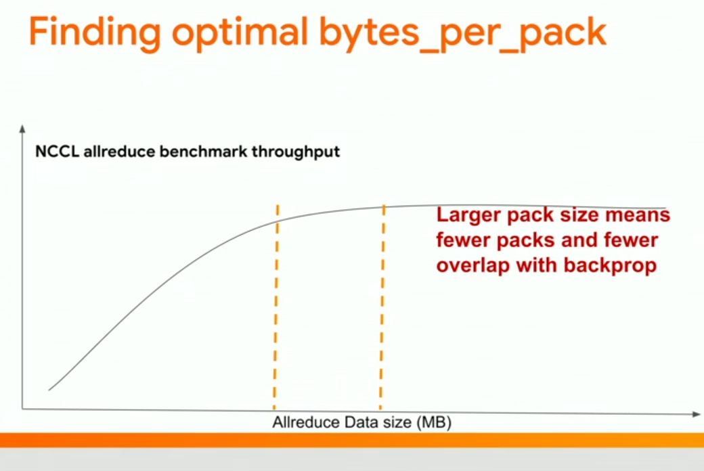
Experiment Optimization Overlapping Gradient Backpropagation

Slide 59
5.
Experiment -- Demo

